Slide 1
Greek Theatre in Context
Theatre 1

Slide 2
Mimesis
Mimesis is a complex Greek term.
Why? Because we’re dealing with two different translations.
  Plato’s translation: imitation is pejorative, like imitation crab meat – its just not as good as the real thing.
  Aristotle’s translation: representation has a slightly more positive connotation.

Slide 3
Dithyramb
The dithyramb is choral chanting.
12-15 choral members consisting of men or boys, and a choral leader who would lead the call and response.
This would all be spoken in the third person (he, she, it, they said...). NOT in FIRST PERSON, until...

Slide 4

THESPIS
The first actor to step away from the chorus.
What does it mean to “step away”?
  He creates the dialogic experience.
    By separating himself he creates the representation of the back and forth relationship between the choral leader and the chorus. However, not only that, he does so AS the character.
Thus, Thespis becomes the 1st Western Actor
  He Creates Theatrical MIMESIS!

Slide 5
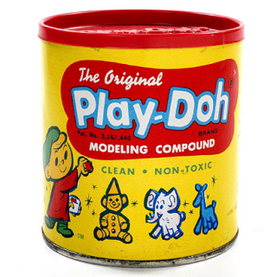
PLATO
1st Person Western History to use the term ‘mimesis’
1st written records of mimesis can be found in Plato’s The Phaedo and The Republic.
Plato perceives mimesis negatively: “mimesis is the process of doubling where one thing becomes two” – The Republic

Slide 6

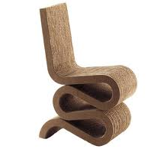
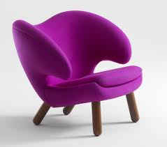

Realm of Forms
Plato’s concept of reality is his platform for his negative spin on mimesis.
Imitations can negatively influence and potentially disregard forms.
Chair is Complete: We can conceive of chairs because of their “chair-ness”
We look for the common thread.

Slide 7

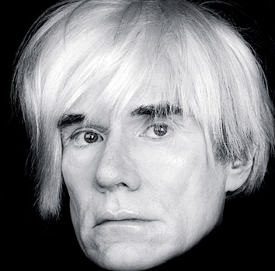
Plato’s Concern was this...
+
=

Slide 8

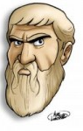
WHAT’S THE
POINT?!?!

Slide 9
Realm of Forms
What is the state (or nature) of justice? Government? Love? – To conceive of these things we have to think of them in the manner of form.
Form is its essence, idea, category.
After FORM is ITTERATIONS.

Slide 10
Itterations
Plato: WHY ARE YOU WASTING YOUR TIME MAKING ITTERATIONS?!?!
Itterations are distracting – particularly to young people.
Many adults feel the same way today about your generation...

Slide 11
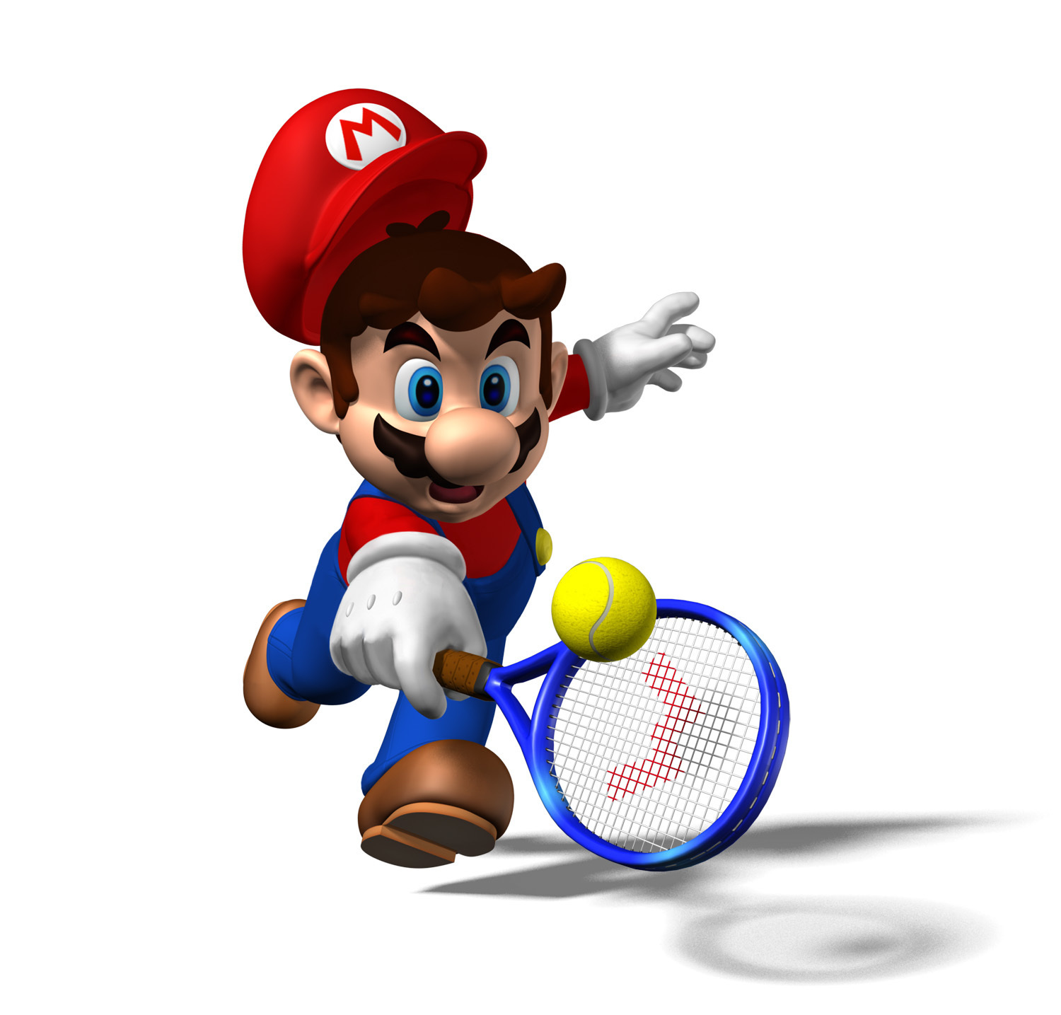

Modern Day Itterations
VS.

Slide 12

Aunt Lynda says...

Slide 13
Plato’s Hierarchy
1 : Realm of Forms (Pure and Good)
2 : Itterations (Bad)
3 : Mimesis (Lies!)
Plato believed that drama tells misleading half-truths or lies.
Platonic Prejudice: don’t live in a world of fiction – live in the present and try to comprehend what’s real.

Slide 14
Plato & the World We Know
Avg. American watches 7 hours of TV a day.
Plato would be concerned that we are getting lost in a world of mimesis.
Now, the ultimate Platonic Nightmare

